Slide 1
Spectral Signatures and Spatial Coherence of “Bound” and “Unbound” Polarons in P3HT Films: Theory vs Experiment
Raja Ghosh
Supervisor: Prof. Frank Spano
Temple University
1

Slide 2
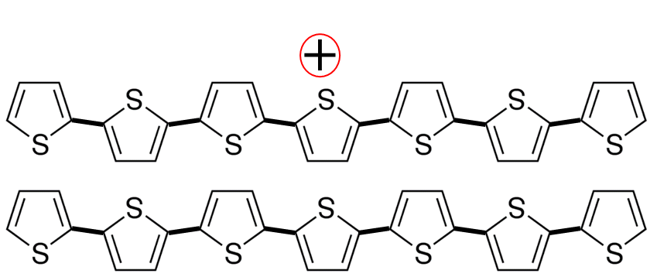
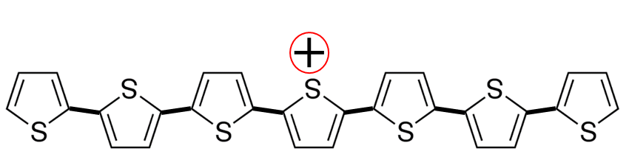
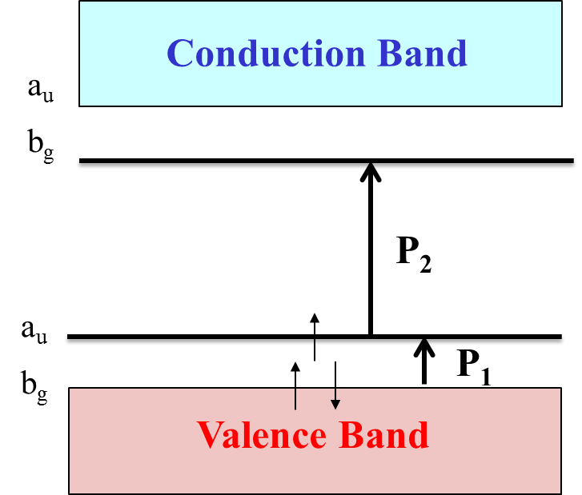
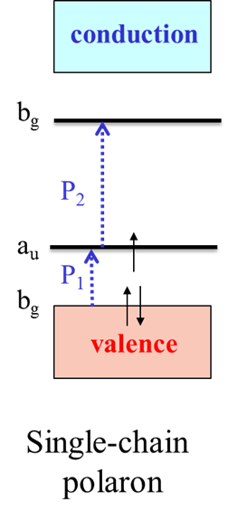
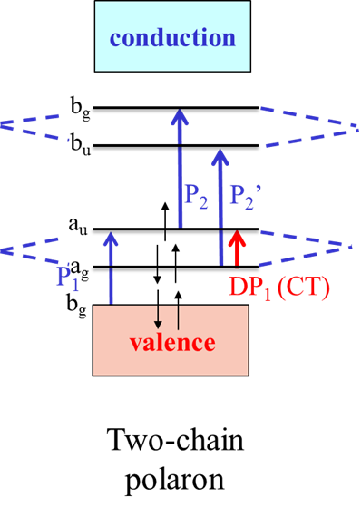
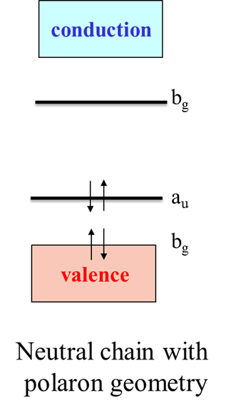

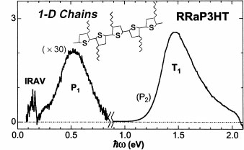
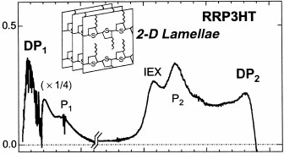
Single Chain Polaron
Interchain Polaron
Osterbacka et. al. Science 2000
P3HT Chain
Background
Interchain
Interactions
2

Slide 3
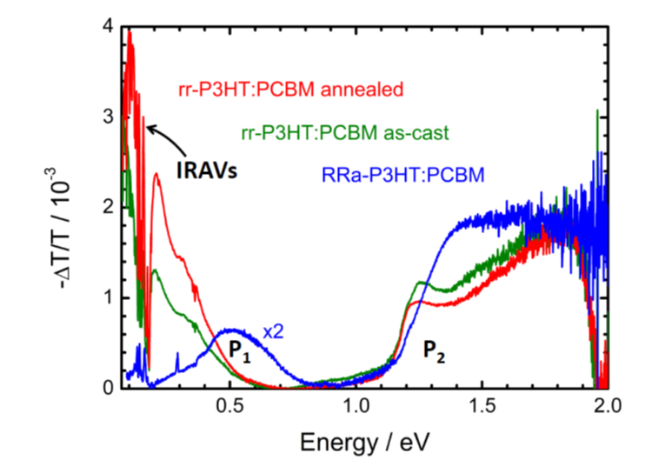
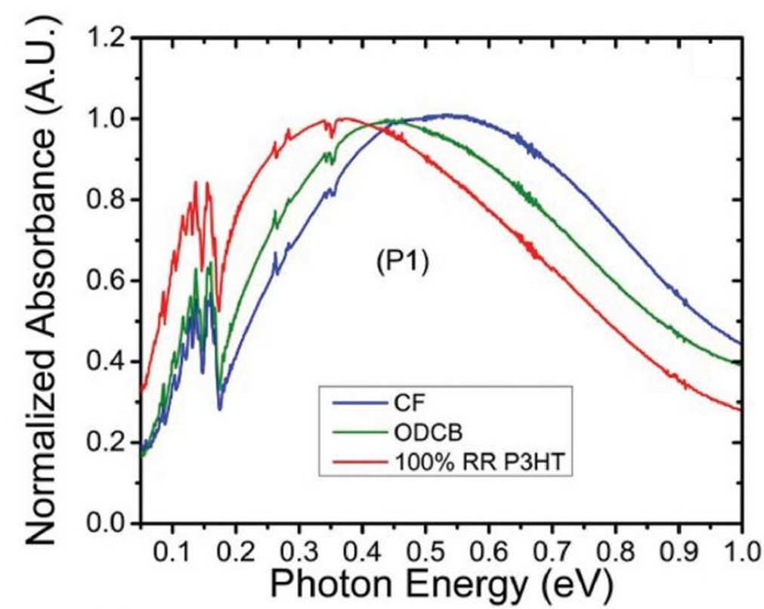
Undoped P3HT Films
F4TCNQ doped P3HT Films
A
Increasing Order
Increasing Order
B
A
Background
B
Kahmann, et. al, J. Mater. Chem. C 6, 6008 (2018).
Scholes, et al. Adv. Funct. Mater. 2017.
With Increasing order and crystallinity in the sample,
Peak B and A redshifts.
Peak A increases in intensity
What is the nature and origin of the two peaks?
3

Slide 4

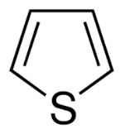
Modelling Polymer Aggregates with Vibronic Coupling: Holstein Hamiltonian
Shine light
+
P3HT backbone
0.35 – 0.40 nm
t_{intrachain}
t_{interchain}
+
Theory
P3HT stack
Interchain
Intrachain
What are the mid- IR Spectral Signatures of Delocalized Polarons?
Charge delocalization
Over what distances are holes/Polarons delocalized along the backbone in a P3HT chain?
and
How many Chains?
Vibronic coupling
4
R. Ghosh, C. M. Pochas, F. C. Spano, J. Phys. Chem. C 2016, 120, 11394.

Slide 5
Polaron Coherence and Spectral line shape
Developed a relation between Oscillator strength and Coherence function:
The 2D hole coherence function is given by :
Coherence is promoted by strong electronic coupling and hindered by disorder and vibrational coupling
Theory
5
R. Ghosh, C. M. Pochas, F. C. Spano, J. Phys. Chem. C 2016, 120, 11394.

Slide 6
Polaron Coherence and Spectral line shape
Site disorder, σ = 0.2 eV
Site disorder, σ = 0.4 eV
No disorder, Ideal Polymer
N_{intra} = 5.23 (1.7 nm)
N_{inter} = 5.15 (1.66 nm)
N_{coh} = 28 (2.8 nm²)
Delocalized hole
+
+
+
Energy
N_{intra} = 4.28 (1.31 nm)
N_{inter} = 3.66 (1.064 nm)
N_{coh} = 17.70 (1.4 nm²)
t_{intrachain}
Localized hole
Position along the chain
N_{intra} = 2.76 (0.704 nm)
N_{inter} = 2.10 (0.44 nm)
N_{coh} = 7.08 (0.31 nm²)
Δ_{m,n} chosen randomly from
a Gaussian distribution of width σ
6

Slide 7
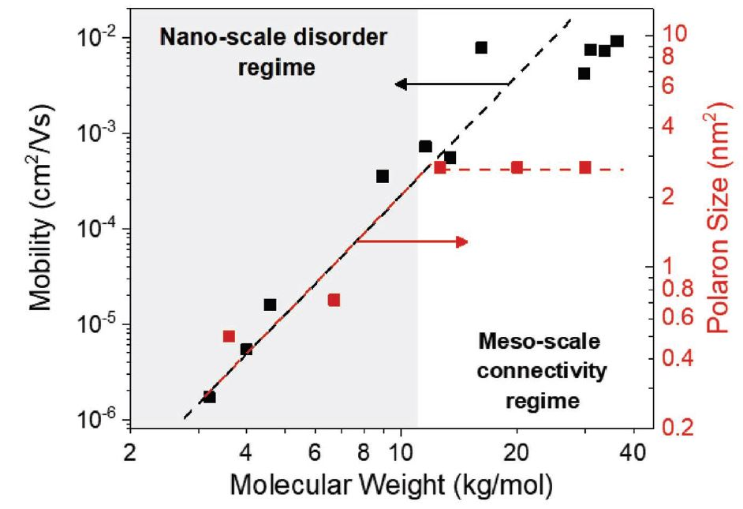
Undoped P3HT Films: Comparison to Experiment
(Electrically Generated holes- Charge-Modulation Spectroscopy)
N_{intra} = 5.23 (1.7 nm)
N_{inter} = 5.00 (1.6 nm)
N_{coh} = 28 (2.72 nm²)
Take Home message
Increase in mobility below 12.6 kg/mol is due to progressively greater interchain order.
Increase in mobility above 12 kg/mol is due to increased crystalline connectivity via tie chains.
N_{intra} = 5.12 (1.65 nm)
N_{inter} = 2.14 (0.456 nm)
N_{coh} = 12.44 (0.75 nm²)
A.R Chew, R. Ghosh, V. Pakhnyuk, J. Onorato, E.C. Davidon, R.A. Segalman, C.K. Luscombe, F.C Spano and A. Salleo, Unraveling the Effect of Conformational and Electronic Disorder in the Charge Transport Processes of Semiconducting Polymers, Adv. Funct. Mater. 2018, doi.org/10.1002/adfm.201804142
7

Slide 8
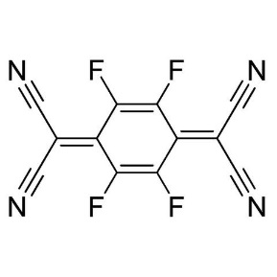
Modelling Doped Polymer Chains: F4TCNQ doped P3HT films
+
Coulomb Interaction between hole and anion
Point charge
8

Slide 9
Origin and nature of Polaron Peaks A and B
P3HT Chain having 10 thiophene units
Coulomb Interaction isolates 2 polaron levels
+
+
d_{anion}
0.2 nm
Energy
0.2 nm
t_{intrachain}
_{I}
_{II}
I and II are in resonance and electronically coupled by the hole transfer integral
V_{I}
Position along the chain
9

Slide 10

Origin of Polaron Peaks: Herzberg-Teller Coupling
AntiSymmetric State
No vibronic coupling, disorder
t_{intrachain}
_{I}
_{II}
(Peak B)
2t_{intrachain}
Herzberg Teller Coupling
Treat vibronic coupling, disorder pertubatively
(Peak A)
$$ℏw$$
Symmetric State
10

Slide 11
Single P3HT Chain
IR Spectrum vs. Anion – Chain Distance
DisorderedP3HT Chain having 10 thiophene units
+
+
+
+
+
+
d_{anion}
d_{anion}
d_{anion}
d_{anion}
d_{anion}
0.8 nm
1.0 nm
0.6 nm
0.4 nm
0.2 nm
Peak B red-shifts
Peak A increases in intensity
11

Slide 12

Interchain Effects: π-stacks
Delocalized Polaron
Take Home message
Peak A has higher intensity than peak B.
Peak A has both intrachain and interchain component.
+
Bound Polaron
+
Take Home Message
Peak B has higher intensity than peak A
Peak A is mainly intrachain.
Ghosh et al., Spectral Signatures and Spatial Coherence of Bound and Unbound Polarons in P3HT Films: Theory Versus Experiment. J. Phys. Chem. C , 2018, 122, 18048
12

Slide 13
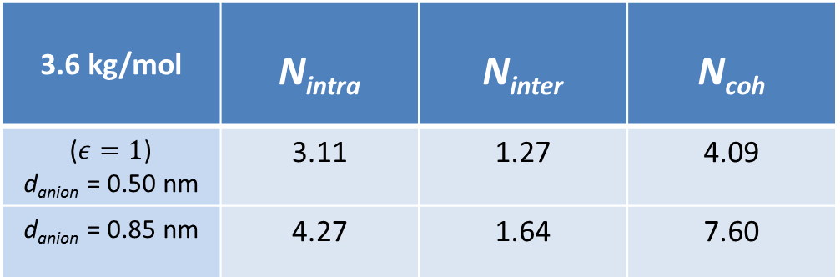
F4TCNQ-Doped Films: Comparison to Experiment
N_{intra} = 4.04 (1.22 nm)
N_{inter} = 1.62 (0.25 nm)
N_{coh} = 7.35 (0.302 nm²)
Ghosh et al., Spectral Signatures and Spatial Coherence of Bound and Unbound Polarons in P3HT Films: Theory Versus Experiment. J. Phys. Chem. C , 2018, 122, 18048
13

Slide 14
Polarized P3HT measurements: Comparison to Experiment
Take Home Message
Peak A cannot be explained by conventional Polaron theory and has contributions from intrachain component too. Peak A arises due to Herzberg Teller Coupling mechanisms
Low energy polaron signatures contain valuable information about polaron coherence, charge mobility.
Are there really any mid-gap states?
Do we need to review the definition of Polaron?
Manuscript under preparation, 2019
14

Slide 15
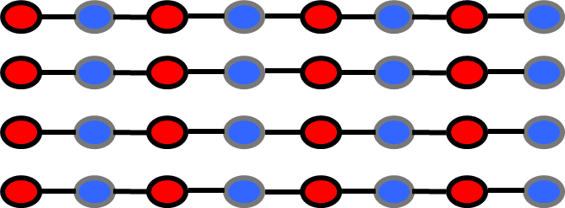
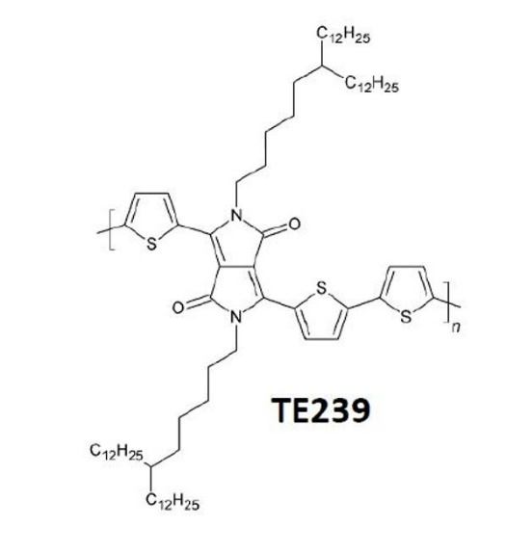
Future Work: Donor Acceptor Copolymers
D
A
D
A
D
A
D
A
Segregated π−stack
Mixed π−stack
Manuscript under preparation, 2019
15

Slide 16



Theory
Frank Spano
Student:
Raja Ghosh
Acknowledgement
Theory
Characterization
teams
Characterization
Prof. Alberto Salleo
Students:
Dr. Annabel Chew
Zhengrong Shang
Theory
Synthesis
Synthesis
Prof. Christine Luscombe
Students:
Jonathan Onorato
Viktoria Pakhnyuk
Synthesis
Characterization
16

Slide 17

Acknowledgement
Funding
Prof. Benjamin Schwartz (UCLA)
Prof. Martin Brinkmann (University of Strasbourg)
Dr. Nicholas Hestand (University of Chicago)
Dr. David Bialas
Chuwei Zhong
April Oleson
Mohammad Balooch Qarai
THANKS to
For No TA duties!!
17

Slide 19
Polarons (holes) in Semiconducting Polymers:
Conventional Interpretation
P3HT Chain
+
Single Chain Polaron
Background
P1 and P2 are mid-gap/Polaron states
Osterbacka et. al. Science 2000

Slide 20



Polarons (holes) in Semiconducting Polymers:
Conventional Interpretation
+
Interchain Polaron
Background
Interchain Interactions
Osterbacka et. al. Science 2000

Slide 21
Undoped P3HT Films: Comparison to Experiment
(Electrically Generated holes- Charge-Modulation Spectroscopy)

Slide 22
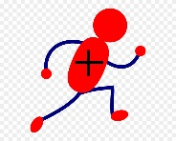
+
+
+

Slide 23
Modelling Disordered Polymer Chains
+
N_{intra} = 5.23
N_{inter} = 5.15
N_{coh} = 28
N_{intra} = 4.28
N_{inter} = 3.66
N_{coh} = 17.70
+
Energy Levels
+
N_{intra} = 2.76
N_{inter} = 2.10
N_{coh} = 7.08
Δ_{m,n} chosen randomly from
a Gaussian distribution of width σ

